Slide 1

Statistical and Predictive Modeling for Analytics II
Assignment – 5
Support Vector Machines
Presented By
Kartik Sojitra (100723768)

Slide 2
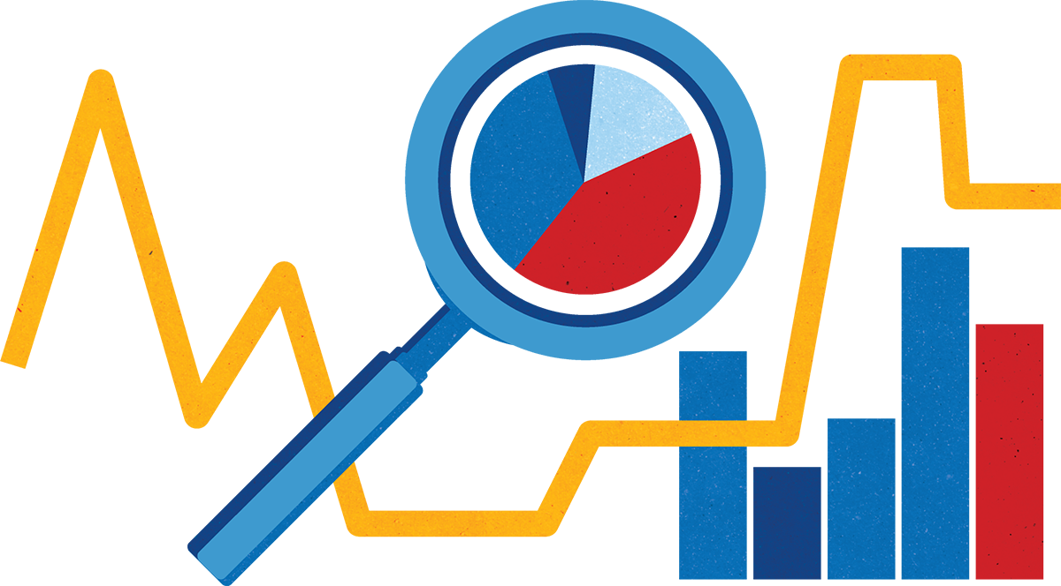
Table of Contents
Description of the Problem
Description of the Analysis
Learning Curve of SVM Model
Standard vs Optimized Model
Optimized SVM vs Optimized LDA
Recommendations

Slide 3

Description of the Problem
Mr. John Hughes wants to determine that support vector machines would better perform cancer datasets.
Mr. John Hughes wants to determine the standard and optimized SVM model impact by comparing both models based on the previously optimized LDA’s outcome.
SVM model helps Mr. Hughes for both classification and regression problems for both categorical and numerical datasets.
In the dataset, there are 10 independent variables (id, Clump Thickness, UofCSize, UofCShape, Marginal Adhesion, SECSize, Bare Nuclei, Bland Chromatin, Normal Nucleoli, Mitoses) and 1 dependent variable (Class).

Slide 4
Description of the Analysis
I would be using the SVM algorithm that would help in the separation of classes for avoiding overlapping and makes the model more accurate in the cancer dataset.
Support Vector Machines, it is a descriptive classifier that separates the hyperplane of every non-linear class.
By kernel function it would map the data to higher-dimensional spaces to deal with nonlinear data, which defines as the Kernel trick.
Here, using both the standard model and optimized model will affect the accuracy of the model, solves the problem of hyper tuning and tradeoffs.
We are using SMOTE to balance the classes before running the model in the cancer dataset.

Slide 5
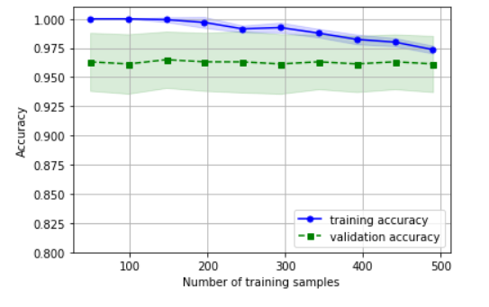
Learning Curve of SVM Model
The SVM model learning curve compares the performance of a model on training and testing data over a varying number of training instances.
The gap between the training and validation accuracy is high which represents that this model is suffering from high variance.
We can determine from the graph that there is a problem of overfitting and to resolve this problem we can collect more training data, reduce the complexity of the model.
SVM model has higher ‘Accuracy’ value. Here our y-axis is ‘Accuracy', not ‘RMSE', so the higher the ‘Accuracy’, the better the performance of the model.

Slide 6
Standard vs Optimized Model
Standard SVM Model
SVM is being used for the standard outcome without adding hyperparameters to the model.
For optimization of the model, using standard scaler entire dataset has been scaled for normalization.
In the model, the learning curve helps for the complex dataset that determines predictive accuracy on test data and training sample function.
Optimized SVM Model
Optimized model SVM using grid search adding bets parameters which would help in solving overfitting problems to the model.
By adding best hyperparameters to the optimized model to avoid trade-offs, the probability for having low bias and for better accuracy.
In the model training score and validation score would measure estimated errors for the model.
Con’t…

Slide 7
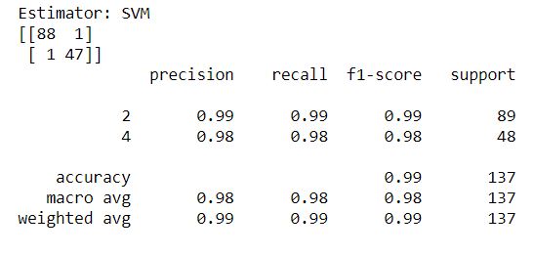
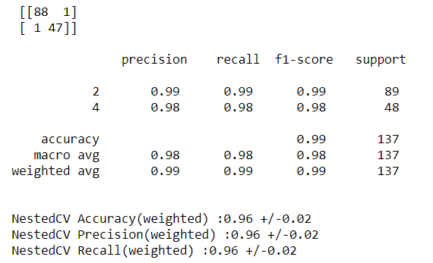
Now, adding parameters for SVM optimization – gamma parameter defines high and low values that describe the distance for training samples.
It would be defining the model optimized score for SVM using accuracy score, precision, recall, and MLA parameters.
We can identify that tuning hyperparameters affect model accuracy and Mr. Hughes can choose the best model by comparing both model's outcome.
Looking at accuracy score for both models; Standard model – 0.99 and Optimized model – 0.99, both models have better accuracy.
NestedCV for optimized SVM model is 0.96 +/- 0.02 and 0.96 +/- 0.02 respectively which is often used to train a model in which hyperparameters also need to be optimized.

Slide 8
Optimized SVM vs Optimized LDA
Mr. Hughes would be more successful by using Optimized LDA, by comparing Optimized LDA and SVM model for cancer dataset.
Considering Train accuracy, Precision score and Recall score for Optimized LDA model are 0.99, 0.99 and 0.99 respectively, depicts a good accurate model for cancer dataset.
However, Optimized SVM shows good model accuracy by considering Train accuracy, Precision score, and Recall – 0.99, 0.98 and 0.98.
To conclude Mr. Hughes must use an optimized LDA model because SVM focuses only on the points that are difficult to classify whereas LDA focuses on all data points.

Slide 9
Recommendations
Comparatively, Both models are accurate therefore standard model is recommended for the SVM because of its less complexity and it takes very little time to run compared to the optimized model.
I recommend Mr. Hughes for preprocessing step - Principal Component Analysis, before evaluating algorithm.
In the long term, for larger dataset PCA would help in preprocessing dataset by principal component for data points. PCA eliminates all variance, redundancy and correlation between variables.
The smaller dataset like cancer for best model accuracy more variables and features to be added and, for the larger and complex data set feature selection to be done for avoiding high bias and trade-offs.
It is best to feature scaling in Logistical Regression in categorial and discrimination problems.

Slide 10


